Slide 1
Factor Rotation Strategy
Practice of QCF
Crist, Hills, Mitchell, Nechtman

Slide 2
Reference Paper & Introduction

Slide 3
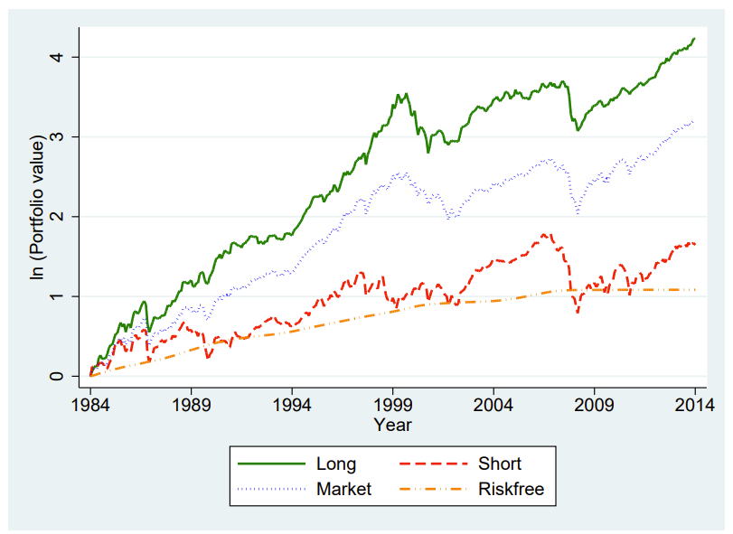
Reference Paper
“Does History Repeat Itself? Business Cycle and Industry Returns”, Journal of Monetary Economics
Chava, Hsu and Zeng
Measures RSR’s (regime Sharpe ratios) of equity sectors in different economic regimes
Creates a L/S rotation strategy based on high and low RSR’s in different regimes, with the belief that changes in expected cash flows creates price differentials between sectors
Generated excess returns of 8.45% and 14.02% alpha in the Fama-French five-factor model

Slide 4
Project Abstract
Analyze the Fama-French five Factor model to evaluate if there is enough diversification for a trading strategy
Build a robust model to measure the economic cycle in a robust way
Use the economic cycle model as a signal for a long/short trading system using the FF 5 factors
Seek to replicate the Reference Paper with a few differences
Factors instead of sectors
See if certain factor premiums are specific to certain economic regimes
Robust economic cycle model
A dynamic predictive model that has a higher signal frequency than annually
Trade optimization
Evaluate different trading optimization techniques rather than just RSR’s

Slide 5
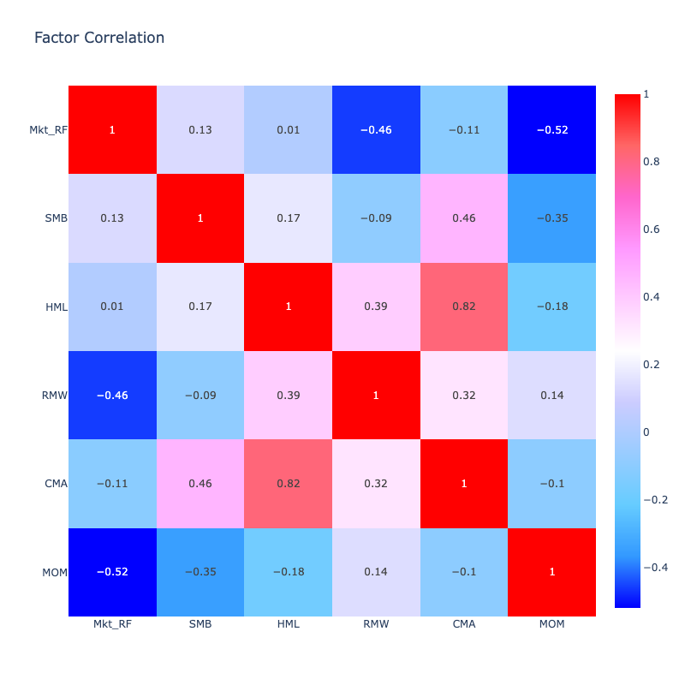
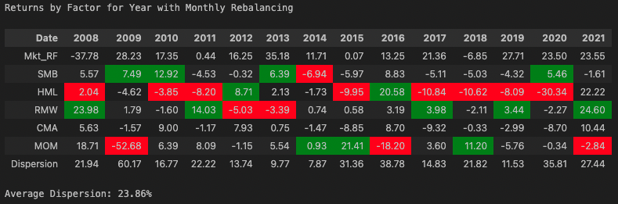
Factor Analysis
The high factor dispersion demonstrates the Alpha potential through factor rotation
The negative correlation amongst factors suggest there is also directionality to this dispersion where pairs trading can be profitable

Slide 6
Economic Models

Slide 7
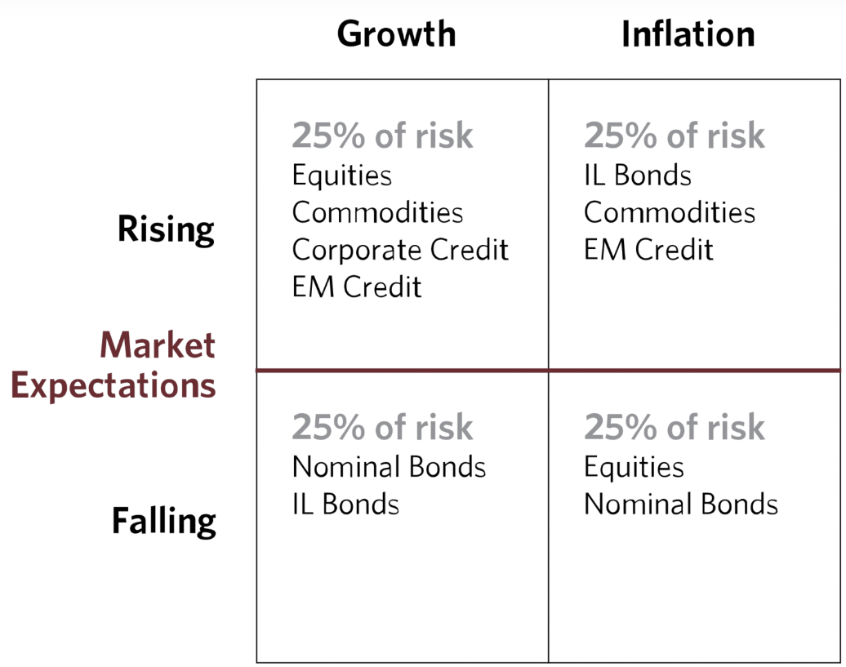
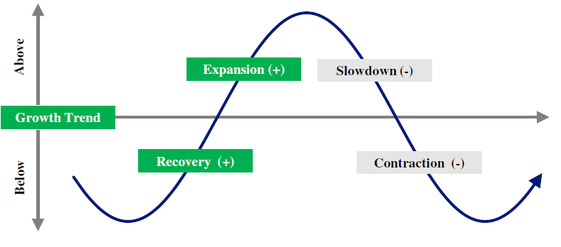
1st Model: GDP-CPI Model
Quarterly Lagged
Rotation frequency also quarterly so stuck with factor for longer period if regime changes
Tends to be revised after it has been first published which could lead to a larger discrepancy.
Source: “All Weather Strategy”,
Ray Dalio & Bridgewater Associates
Notes:
Motivation for this strategy was based on Bridgewater all weather strategy. They determine 4 different regimes based on rising/ falling growth or inflation. The type of regime they determine they are in drives their decision making for how to weight the portfolios. We attempted to create a similar framework using GDP and CPI as data for a model in determining the type of regime. Lagged data isn't responsive enough.

Slide 8
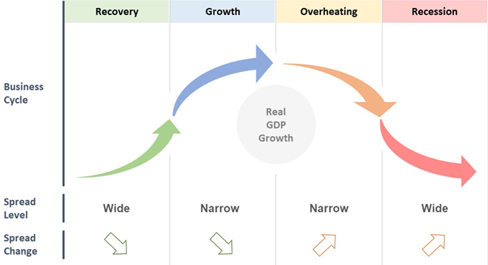
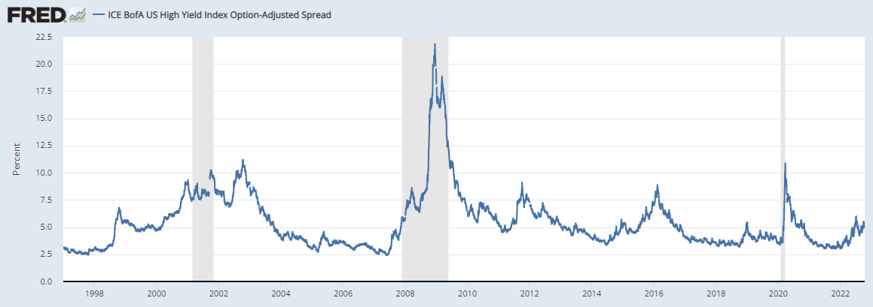
2nd Model: High Yield Model
The High Yield spread is a real time indicator of investment flows
Available daily for frequent signaling
Not a lot of data on the spreads for high yield only going back to 1996
Source: “Why You Should Be Following High-Yield Spreads”,
Dan Rasmussen & Igor Vasilachi
Notes:
Predefined model and how the high yield moves with the business cycle. Model i

Slide 9
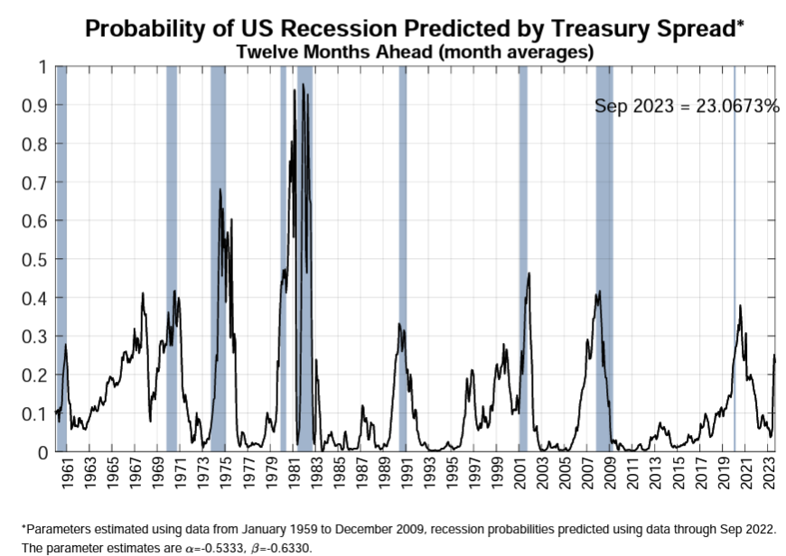
3rd Model: Machine Learning
Sought out a more robust Economic Signal
Wanted to test the strength of the Yield Curve as a predictor of economic regimes
The reference paper used simple methods of just measuring the spread between different points on the yield curve
We created a more robust model using pipeline of PCA then K-means clustering of the yield curve rather than traditional spread measures
Source: “The Yield Curve as a Leading Indicator”,
Federal Reserve Bank of New York
Notes:
We wanted to try something more robust than just the trends.
Hypothesis: people use the shape of the yield curve as in.dicators for macroeconomic conditions, could we apply the same theory here, in a more quantitative way. This was based on other models that used the yield curve but for most tasks were just binary classification. We wanted to use it to generate labels.
Our pipeline was to use PCA and then K-Means clustering to group the yield curve data. Then use the clusters as labels of economic cycle.

Slide 10
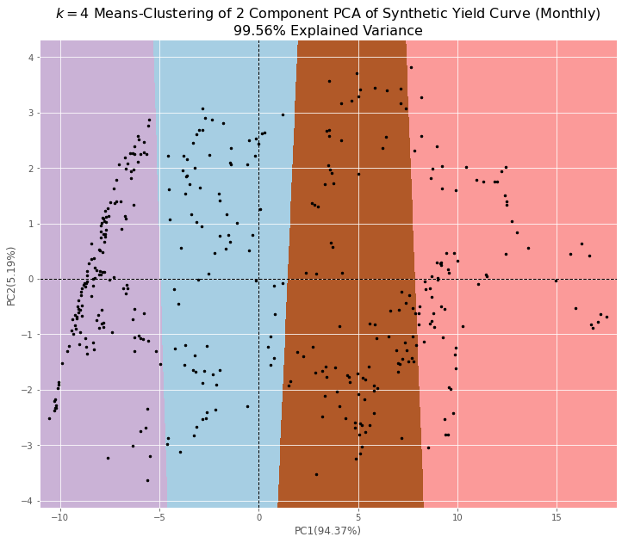
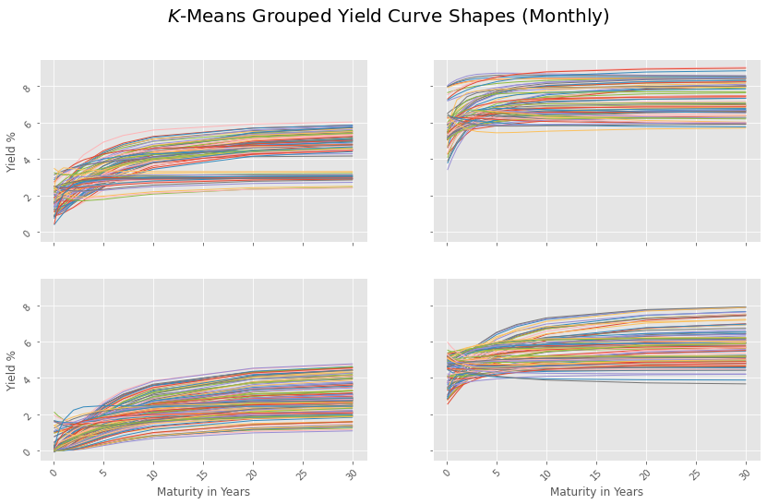
3rd Model: Machine Learning Cont’d
First 2 Principal Components of Yield Curve
4 clusters of Yield Curve Shapes
Notes:
Data Problems: We sought to use PCA to reduce dimensionality based on literature.
However, with Treasury maturities auctioned for periods of time, we were left with many missing values, incompatible with PCA, that needed to be addressed.
Mean-Fill? Back-Fill? These introduce bias and from a model testing perspective, we shouldn’t incorporate future knowledge (or even past if we are randomly testing our strategies).
How to fill? Nelson-Siegel model.
Well researched.
Only incorporates information known at time of calibration (i.e., calibrate based on rates today, compute yield for any maturity, done for each data point).
Accuracy: to compare data computed by Nelson-Siegel (our synthetic data), we took the Nasdaq/FRED obtained data, NaN filled with zeros, and used the indices of NaN’s to fill the synthetic data with zero’s in the same spots.
MSE of monthly synthetic data compared to actual: 1.43e-3
MSE of daily synthetic data compared to actual: 5.31e-7
Also incorporated some other safety nets such:
NS Model can spit out very strange data points that wouldn’t make sense (numpy.linalg errors), we set some ceilings such as the max rate of original data frame to prevent these values

Slide 11
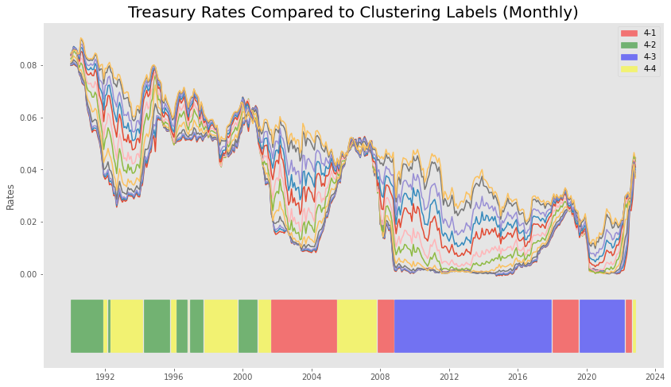
3rd Model: Machine Learning Cont’d
This model did not produce the intended results
The dominance of the variance by the level component does not properly demonstrate changing economic regimes
The continued drop in yield levels over the last 30 years has not followed a cycle
The Green/ Blue labeled regimes exist solely pre/post the GFC and do not repeat
Economic regimes should repeat and follow some expected flow as the economic cycle repeats itself over time
Notes:
Next: Since the pipeline of PCA followed by clustering results in these persistent regimes, or regime changes not identified by our model, we then eliminated the PCA step and tested many different clustering algorithms, even those not appropriate for the task at hand.
All models delivered comparable results: persistent labels that missed regime changes.
Clustering models include:
Affinity Propagation
Agglomerative Clustering
BIRCH Clustering
DBSCAN
Gaussian Mixture Models
Mean Shift Clustering
All performed comparable when optimized.
These results suggest that the yield curve alone is not enough to generate a robust signal representing the regimes of the economy. While we tested methods that remove the first principal component, effectively removing the overbearing weight level has on the output, the removal of the first principal component leaves the rest at a very low total explained variance.

Slide 12
Trading Strategies

Slide 13
Trading Strategy
Models Tested
Generated signals from economic Models
Used different variations of Yield Curve
Instruments Traded
Originally traded strategy with just FF 5 factor
Tested on Invesco factor ETF’s
Trade Optimization
Selected instruments with highest RSR
Tried Long only & L/S
Strategy Backtesting
Trained over rolling windows
Excluded GDP/CPI
Looked at highest total return and minimized VaR
Tested on out of sample returns using random samples
Also tested on defined sampling

Slide 14
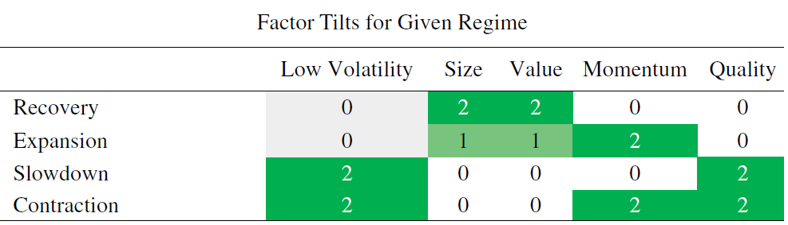
Trading Instruments - Invesco
Invesco created a dynamic strategy using factor rotation throughout the cycle
Published their findings in the JOIM
Created a successful product that has generated positive Alpha (Invesco Russell 1000 Dynamic Multifactor ETF)
Took a different approach of trading Equity Factor funds with beta vs. pure FF factors
Source: “TIME-SERIES VARIATION IN FACTOR PREMIA: THE INFLUENCE OF THE BUSINESS CYCLE” Journal of Investment Management,
Christopher Polk, PhD, Mo Haghbin, CFA, CAIA and Alessio de Longis, CFA
 | Min Var | Revenue | Growth | Value | Quality | Momentum | SPX
Min Var | 1
Revenue | 0.91 | 1.00
Growth | 0.72 | 0.81 | 1.00
Value | 0.83 | 0.92 | 0.65 | 1.00
Quality | 0.88 | 0.92 | 0.81 | 0.79 | 1.00
Momentum | 0.72 | 0.76 | 0.85 | 0.57 | 0.77 | 1.00
SPX | 0.90 | 0.96 | 0.90 | 0.82 | 0.95 | 0.85 | 1.00

Slide 15
Strategy Performance
Model: | Yield Curve PCA | Yield Curve PCA W/O level | Yield Curve PCA W/O level | 3rd PCA only (Curvature) | High Yield
Instruments: | FF-5 | FF-5 | Invesco ETF | Invesco ETF | Invesco ETF
Market | Mkt-RF | Mkt-RF | S&P 500 | S&P 500 | S&P 500
Returns | 12.4% | 12.4% | 11.7% | 11.7% | 13.1%
Vol | 14.9% | 14.9% | 14.8% | 14.8% | 14.1%
Sharpe | 0.84 | 0.84 | 0.79 | 0.79 | 0.93
Long Only
Return | -0.9% | -0.8% | 12.7% | 14.2% | 14.8%
Vol | 9.4% | 8.2% | 14.7% | 20.4% | 16.2%
Sharpe | -0.10 | -0.09 | 0.87 | 0.70 | 0.92
Beta | 0.06 | -0.10 | 1.07 | 0.90 | 0.90
Alpha | 0.78% | 0.99% | 1.01% | 0.90% | 1.20%
Long/Short
Return | -2.4% | -4.5% | 3.0% | 4.0% | 5.5%
Vol | 17.6% | 12.2% | 10.5% | 12.7% | 12.4%
Sharpe | -0.14 | -0.36 | 0.29 | 0.31 | 0.44
Beta | 0.21 | 0.09 | 0.24 | -0.14 | 0.03
Alpha | 0.77% | 1.05% | 1.03% | 0.90% | 1.44%
Highest Alpha Strategy
High Yield Model
Invesco Equity Factor Indices
Long Only Strategy Tilts
Recovery – Value
Expansion - Value
Slowdown – Momentum
Contraction – Min Variance
Long/Short Strategy Tilts
Recovery
Long: Value, Short: Min Variance
Expansion
Long: Value, Short: Min Variance
Slowdown
Long: Momentum, Short: Value
Contraction
Long: Min Variance, Short: Value

Slide 16
Conclusion

Slide 17
Final Thoughts
Factor vs. Sector Rotation
Could not come close to generating the 14% Alpha from the reference paper
Perhaps suggesting factor rotation is not as robust as sector rotation
Model Creation
Could also not match the Alpha of the Invesco Dynamic Factor Fund
Suggesting their predictive models were more robust than what we were able to model
Signal Turnover
Over the last 5 years the market has progressed quickly through the economic cycle
Some models, like the yield curve PCA and GDP/CPI, were not able to capture it
The High Yield model was one of the most adaptive and also the best returning strategy

